Slide 1

Automotive Technology: A Systems Approach, 8e
Chapter 23: Electrical Accessories
Rob Thompson and Jack Erjavec, Automotive Technology: A Systems Approach, 8th Edition. © 2025 Cengage. All Rights Reserved. May not be scanned, copied or duplicated, or posted to a publicly accessible website, in whole or in part.

Slide 2
Chapter Objectives (1 of 3)
23.01 Explain the basic operation of electric windshield wiper and washer systems.
23.02 Inspect and diagnose concerns with windshield wiper and washer systems.
23.03 Explain the operation of accessories such as horns, clocks, and power outlets.
23.04 Describe how cruise or speed control operates and the differences of various systems.
23.05 Inspect and diagnose cruise control systems.

Slide 3
Chapter Objectives (2 of 3)
23.06 Identify the components of typical audio and video systems.
23.07 Identify and diagnose video and sound concerns.
23.08 Describe the operation of navigation and tracking systems. Explain the operation of power door locks, power windows, power mirrors, and power seats.
23.09 Diagnose problems with power door locks, power windows, power mirrors, and seat systems.

Slide 4
Chapter Objectives (3 of 3)
23.10 Describe the operation of various safety systems such as parking assist, blind spot detection, and obstacle sensing systems.
23.11 Describe the components and operation of the various security systems.

Slide 5
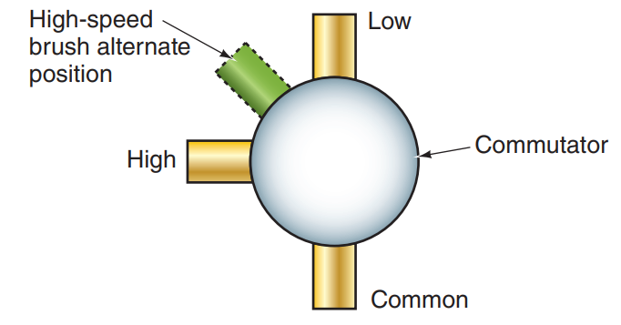
Windshield Wiper/ Washer Systems
23.01 Explain the basic operation of electric windshield wiper and washer systems.
In motors with permanent magnet fields, motor speed is controlled by the placement of the brushes on the commutator.
Three brushes are used: common, high speed, and low speed.
The common brush carries current whenever the motor is operating.
The low-speed brush and high-speed brush are placed in different locations.
The most used motor has the low-speed and common brushes opposing each other, and the high-speed brush is either centered between the two or offset from the two.

Slide 6
Intermittent Wiper Systems
Many wiper systems offer an intermittent mode that provides a variable interval between wiper sweeps.
Many of these systems use a module, or governor, mounted near the steering column, or the system has a module connected to the BCM.
On non-BCM-controlled systems, the delay between wiper sweeps is controlled by a potentiometer.
By rotating the intermittent control, the resistance value changes.
The module contains a capacitor that is charged through the potentiometer. Once the capacitor is saturated, the electronic switch is triggered and current flows to the wiper motor.

Slide 7
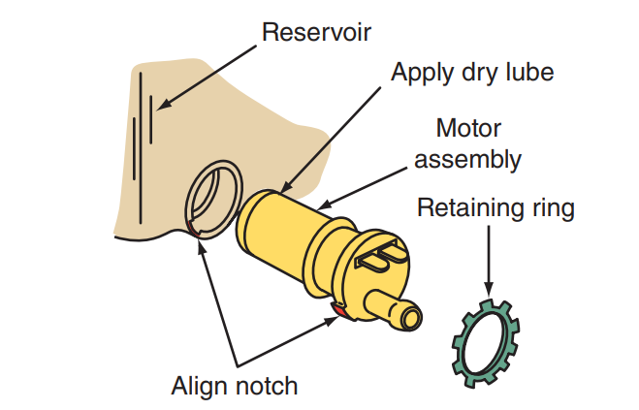
Windshield Washers
Windshield washers spray a fluid onto the windshield and work in conjunction with the wiper blades to clean the windshield.
Most systems have the washer pump installed in the fluid reservoir.
Vehicles with rear wipers typically have two washer pumps in the same reservoir.
Washer systems are activated by holding the washer switch.

Slide 8
Wiper System Service
Customer complaints about windshield wiper operation can include poor wiping, no operation, intermittent operation, continuous operation, or wipers that do not park.
When the wipers move as they should but do not wipe the glass surface the way they should or make noise while moving across the glass, the blades and/or arms should be replaced.
If the wipers work slower than expected, disconnect the wiper linkage at the motor.
Turn on the wiper system.
If the motor runs properly, the problem is the linkage and is not electrical.

Slide 9
Washer System Service
Many washer problems, such as uneven or poor spray patterns, are caused by restrictions in the fluid lines or nozzles.
To check for restrictions, remove the hose from the pump and operate the system.
If the pump ejects a stream of fluid, then the fault is in the delivery system.
The exact location of the restriction can be found by reconnecting the fluid line to the pump and disconnecting the line at another location.
If the fluid still streams out, the problem is after that new disconnect.
If the fluid does not flow out, the problem is before where the hose was disconnected.
Repeat this process until the problem is found.

Slide 10
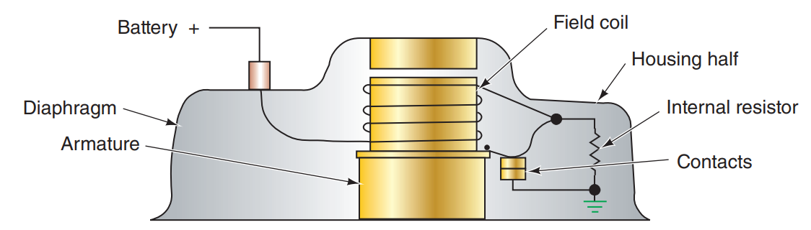
Horns
The electrical horn in automobiles operates on basic electromagnetic principles.
When turned on, a diaphragm in the horn vibrates and emits a noise.
The diaphragm is a thin, flexible, circular plate mounted to an electromagnet.
This mounting allows the center of the diaphragm to flex.
Many horn systems are controlled by relays.

Slide 11
Cigarette Lighter/Power Outlet
The cigarette (cigar) lighter is a heating element that automatically releases itself from the pushed-in position when the appropriate heat level is reached.
Most vehicles have replaced the higher-amperage (20A) lighter with a lower-amperage (10A) accessory power outlet.
For an inoperative system, first check the fuse(s).
If the fuse is good, make certain that power is present at the lighter receptacle.
If power is present, the lighter unit is probably bad.
Power outlets are typically only powered with the key.

Slide 12
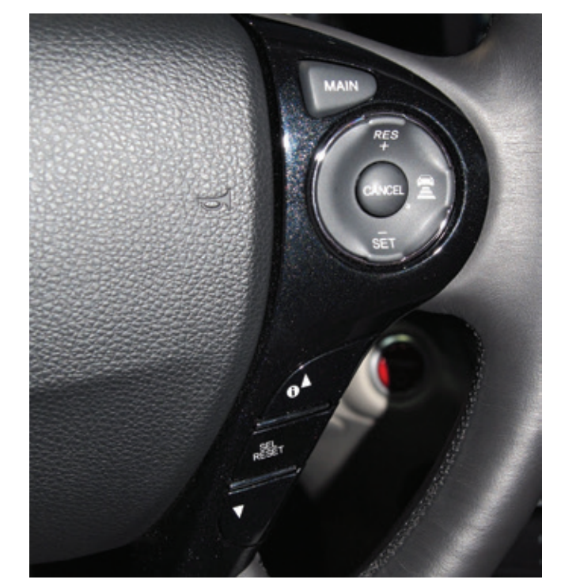
Cruise (Speed) Control Systems
23.04 Describe how cruise or speed control operates and the differences of various systems.
Cruise control systems are designed to allow the driver to maintain a constant speed (usually above 30 mph or 48 km/h) without applying continual pressure on the accelerator pedal.
Selected speeds are easily maintained and can be easily changed.
When engaged, the system sets the throttle position to the desired speed.
The speed is maintained unless heavy loads and steep hills interfere.

Slide 13
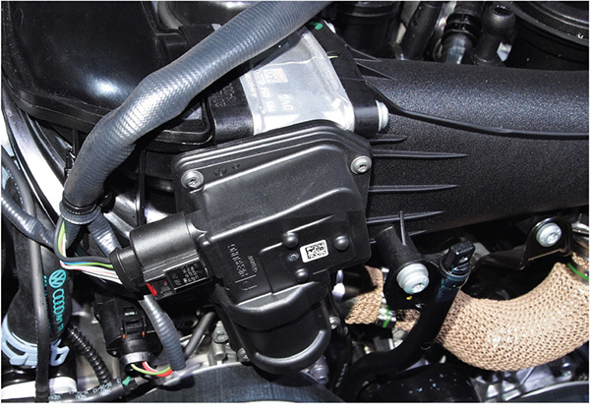
Electronic Cruise Control Systems
Some older systems rely on an electronic control module or BCM to operate a vacuum servo unit or control an electric stepper motor.
If the system is vacuum based, the servo is controlled by supply and vent solenoid valves.
The stepper motor moves a strap attached to the cruise control cable to move the throttle linkage.
The control switch provides a ground circuit through some resistors; these vary the amount of voltage to the control module.
The system also has brake and clutch switches that send a signal to the control module to stop control of the throttle.

Slide 14
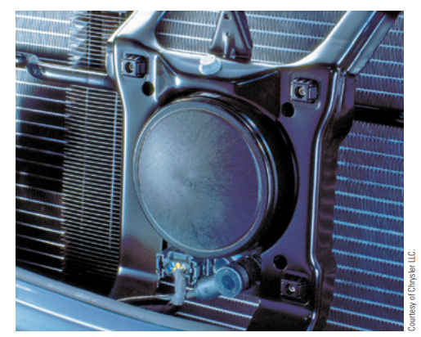
Adaptive Cruise Control (1 of 2)
Most manufacturers have their own version of adaptive cruise control.
Most are radar-based but some use the forward mounted cameras.
Like other cruise control systems, adaptive cruise control automatically maintains the desired speed of the vehicle, but it also maintains a safe distance between vehicles.
The desired distance between vehicles is set by the driver.
The system also adjusts the speed of the vehicle to mirror that of a slower vehicle in front of it, and then maintains that speed.

Slide 15
Adaptive Cruise Control (2 of 2)
23.05 Inspect and diagnose cruise control systems.
Cruise Control System Service
  Diagnosis of these cruise systems is the same as for any other electronic system.
  Diagnostic work is done with a scan tool and DMM.
  Typically, on most late-model vehicles, cruise control problems are caused by faulty circuits, sensors, and/or switches.
  Before connecting the scan tool, check the operation of the cruise indicator lamp.
  If it does not operate properly, test and repair that circuit before proceeding.
  If the light is blinking, the control module detects an electrical fault in the system.

Slide 16
Knowledge Check (1 of 2)
Most manufacturers have their own version of adaptive cruise control and use which two technologies to detect vehicles in front of them?

Slide 17
Knowledge Check Answer (1 of 2)
Answer: Most are radar-based, but some use the forward mounted cameras.

Slide 18
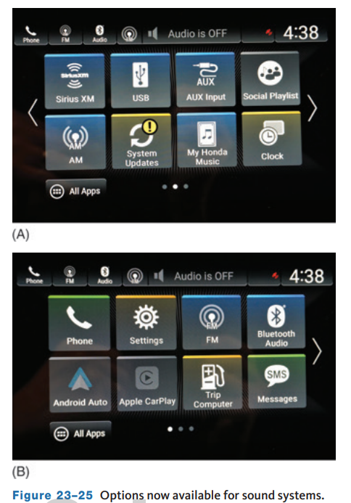
Sound Systems
22.06 Identify the components of typical audio and video systems.
Today, a wide variety of sound systems are available and the complexity of each also varies from basic AM radio to more complex stereo systems that include an AM/FM radio receiver, a stereo amplifier, CD and DVD players, MP3 player, equalizer, several speakers, and a power antenna system.
Many models support streaming audio via satellite radio, Bluetooth, Android Auto, Apple CarPlay, Pandora, and other services.
The current trend in audio systems has been to remove AM reception and eliminate CD/DVD capability in favor of streaming audio.

Slide 19
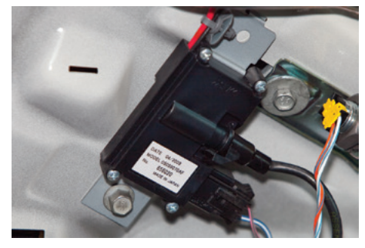
Antenna
An antenna collects radio waves for both AM and FM stations.
Radio stations’ broadcast towers transmit electromagnetic energy through the air and induce an AC voltage in the antenna.
This AC signal is then converted, by the radio receiver unit, to an audio output.
Some vehicles incorporate the antenna into the rear window defogger grid.
A window defogger/ antenna module separates the radio frequencies used by the radio from the current used by the defogger grid.
When the radio is turned on, a 12-volt signal is sent to the defogger/antenna module.

Slide 20
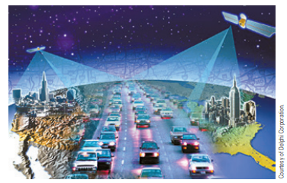
Satellite Radio
To provide broadcast content (e.g., music, live sports, talk) that is not interrupted by distance, most vehicles can be purchased with satellite-based radio as a standard feature or an option.
These radios pick up electromagnetic waves from satellites many miles above the earth and use terrestrial repeater networks in some limited markets to support sound transmission in areas blocked with many high-rise buildings.
Since the microwaves are always transmitted by more than one satellite, and each is in its own orbit or place within the orbit, the same radio station can be heard from coast to coast.

Slide 21
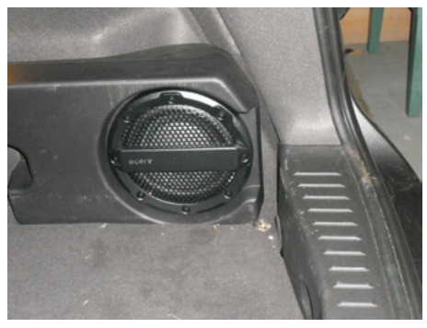
Speakers
Most systems are equipped with several speakers, each designed to produce a different range of sound.
Matching speakers to the system is done by selecting speakers that have the same impedance as the rest of the system.
To achieve a high-quality sound system, the speakers must be placed so that all bouncing is minimized.
Large speakers, called woofers, produce the low frequencies of midrange and bass better than smaller speakers, called tweeters.
Woofers are typically placed toward the rear of the vehicle.

Slide 22
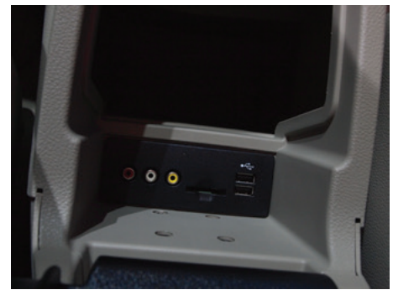
CD Players
A compact disc (CD) player uses a laser pickup to read digital signals recorded on a compact disc.
By converting the digital signals to analog, it can play music and other audio formats.
CD players vary from being able to insert one or more CDs into the main unit to having an auxiliary unit where many CDs can be installed.

Slide 23
Diagnosis (1 of 2)
23.07 Identify and diagnose video and sound concerns.
If the radio system is not working, check the fuses.
If the fuses are okay, check for DTCs and refer to the service information and check the rest of the power and ground circuits for the radio.
If the audio system connects on a MOST bus, special tools may be required for diagnosing system faults.
If the sound system has poor sound quality or poor radio reception, the circuit’s wiring, the antenna, and the speakers should be checked.
If reception is bad, use an ohmmeter to check the ground of the antenna.
Also connect one lead of the ohmmeter to the antenna’s mast and its case; there should be no continuity between the two.
Poor speaker or sound quality is usually caused by damaged speakers, wiring, bent sheet metal around the speaker opening, damaged or missing speaker mounting brackets, or missing or loose attaching hardware or speaker covers.

Slide 24
Telematics
Telematics is a technology that allows the transfer of data over a distance and from remote sources.
It is best defined as the integrated use of telecommunications and Information Technology (IT).
IT is a branch of engineering focused on the use of computers and telecommunications equipment to retrieve, store, sort, and transmit data. Telematics are used by NASA to control the flight of unmanned spacecraft while it is in flight.
Telemetry is widely used by NASA to transmit data and photos from space flights.
Telemetry relates to the transmission of measurements from a remote location to another point where the data can be studied.
Telemetry relies on remote sensors that measure electrical or physical data.

Slide 25
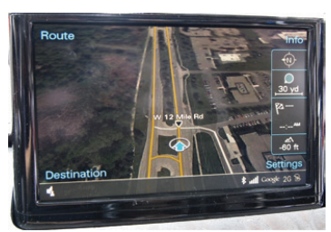
Navigation Systems (1 of 2)
23.08 Describe the operation of navigation and tracking systems. Explain the operation of power door locks, power windows, power mirrors, and power seats.
Navigation systems use global positioning satellites (GPS) to help drivers make travel decisions.
These global positioning systems set up a mathematical grid between the satellites and radio stations on the ground.
Two methods are used to determine the exact location of a vehicle, and both are used simultaneously.
  One is GPS navigation, and the other method is autonomous navigation.

Slide 26
Navigation Systems (2 of 2)
Vehicle Tracking Systems
  Vehicle tracking systems can identify the location of a vehicle if it has been stolen or lost.
  The system is based on the vehicle’s navigational system and/ or the driver’s cell phone.
  When the cell phone is the identifier, the tracking system is triggered when the thief attempts to place a phone call.
  If the correct code is not entered into the phone, the satellite begins to track the vehicle.
  This tracking signal is then monitored by an operator who can call the police in the area where the vehicle is being tracked.
  When the system relies on GPS, a security or police officer can watch the movement of the vehicle on a remote computer screen.

Slide 27
Power Windows
The purpose of any power window system is to raise and lower the windows.
The systems do not vary significantly from one model to another.
The major components of a typical system are the master control switch, individual window control switches and control modules, and the window drive motors.
The master control switch provides overall system control.
Power for the system comes directly from the fuse panel.
Depending on the vehicle, there may be one fuse or circuit breaker for the system or a fuse for each door.
Power for the individual window control switches comes through the master control switch.
When the master switch allows, the other windows can be controlled by the switches located on the associated doors.

Slide 28
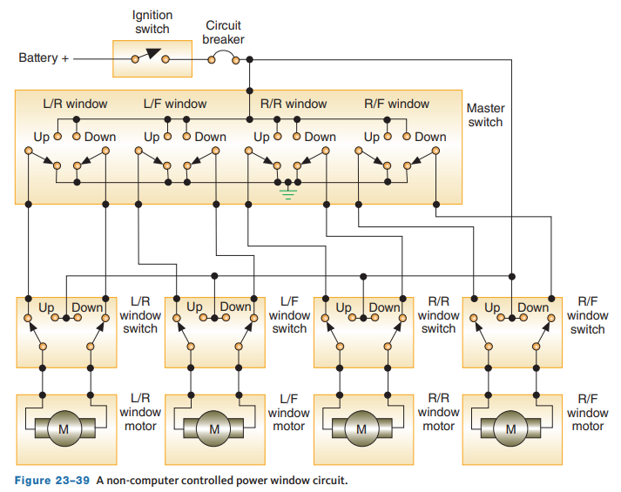
Circuit Operation
Typically, a permanent magnet motor operates each power window.
Each motor raises or lowers the glass when voltage is applied to it.
The direction the motor moves the glass is determined by the polarity of the supply voltage to the motor.
Today, most driver and front passenger doors have a motor with its own module.
Each of the modules is controlled by the BCM.
That signal can cause the window to move up or down and convey the action across the serial data network line to control the rear windows.

Slide 29
Diagnosis (2 of 2)
The first step in diagnosing a power window system is to determine whether the whole system or just one or two windows are not working correctly.
If it is the whole system, the problem can be isolated to fuses, circuit breakers, or the master control switch.
If only a portion of the system does not work, check the components used in the portion that is not working.
A scan tool may allow access to window data and motor controls.
This allows you to monitor switch operation and command of each motor up and down.
To carefully remove the door panels, a special tool is needed, these will reduce the chance of damaging the panel and its retaining clips or rivets.
Once the panel is removed, there is access to the mechanisms for the power door locks, windows and mirrors, as well as the speaker in the door.

Slide 30
Discussion
A scan tool may allow access to window data and motor controls. This allows you to monitor switch operation and command of each motor up and down.
Have a class discussion about how a scan tool would be used for this purpose and what you would expect to see. How would you expect to test the motor? How would you expect to test the switches?

Slide 31
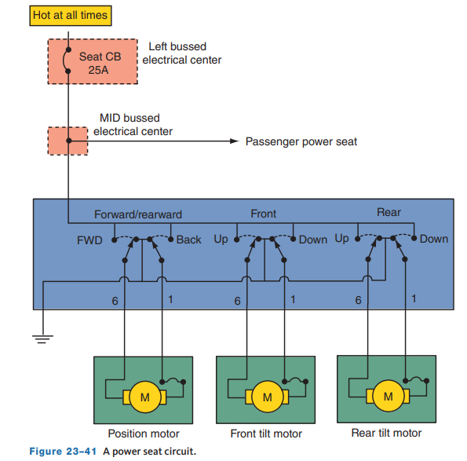
Power Seats
Power seats allow the driver or passenger to adjust the seat to the most comfortable position.
The major components of the system are the seat control and the motors.
Power seats generally come in these configurations: four-way, six-way, and nine-way.
Some vehicles allow the seats to be adjusted in up to 30 ways.
In a four-way system, the whole seat moves up or down, or forward and rearward.
A six-way system has the same adjustments, plus the capability to adjust the height of the front and rear of the seat.

Slide 32
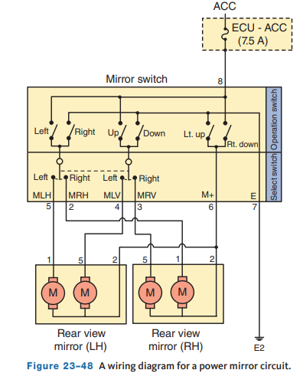
Power Mirror System
The power mirror system consists of either a four-way button switch or a joystick-type control switch and a dual motor drive assembly located in each mirror assembly.
The driver’s door switch assembly has two switches assembled as a single unit.
One switch selects which side mirror, left or right, is to be adjusted. The other switch adjusts that mirror.
A typical power mirror circuit is an independent circuit unless it is tied to the convenience memory system.
In that case, the BCM controls the mirrors along with the seats.

Slide 33
Rear-Window Defrosters and Heated Mirror Systems
The rear-window defroster (also called a defogger or deicer) heats the rear-window surface to remove moisture and ice from the window.
On some vehicles, the same control heats the outside mirrors.
The major components of a rear-window defroster include a switch, relay assembly, and the heating elements on the glass surface.
Pressing the rear-window defroster switch momentarily energizes the relay.
Battery voltage is then applied through closed contacts of the relay to the rear-window defroster grid.
On models with a heated mirror, current also flows through a separate fuse to the mirror’s heated grid.
After about 10 minutes, a time-delay circuit opens the ground path to the relay’s coil and the coil de-energizes, shutting off power to the grids.

Slide 34
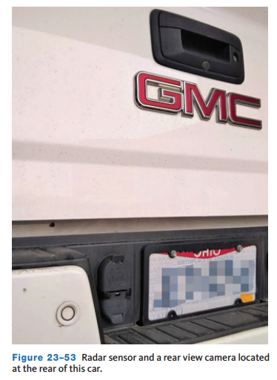
Advanced Driver Assistance Systems (ADAS)
23.10 Describe the operation of various safety systems such as parking assist, blind spot detection, and obstacle sensing systems.
Some vehicles are equipped with forward and/or a reverse sensing system that warns the driver when obstacles are within a designated range of the front and rear bumpers.
These systems have ultrasonic sensors located in the front and rear bumpers to detect any obstacles at the front and rear of the vehicle.
Many vehicles use either sonar or radar sensors that are used for both parking and blind spot monitoring.

Slide 35
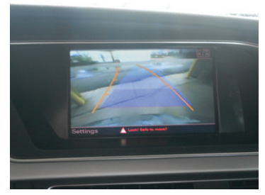
Rear View Cameras
To assist the driver in safely backing the vehicle, newer vehicles have a digital camera that sends signals that display the behind-the-vehicle view on the instrument panel, rearview mirror, or the navigation screen.
To meet NHTSA (National Highway Traffic Safety Administration) regulations, all 2017 and newer passenger cars, light trucks, and vans are required to have backup cameras.
The display allows the driver to see what is behind the vehicle when moving in reverse.
In most cases, the display shows a variety of paths, based on color and the current conditions.

Slide 36
Parking Assist
Using forward and rear sensing monitors and rearview cameras, it allows drivers to park their vehicles easier.
The parking assist control unit calculates the vehicle’s location in regards to other vehicles and obstacles.
The control unit receives signals from the front and rear sensing monitors, the ECM, steering angle sensor, power steering control unit, and ABS control unit.
Tones from the monitoring system become more rapid as the vehicle nears an obstacle.
Normally, the view from the camera is displayed on the navigation screen or an information display in the instrument panel or center stack.
This view is displayed along with reference lines that mark off the area directly behind the vehicle and an additional area showing where the vehicle is headed.

Slide 37
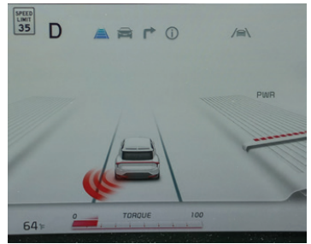
Blind Spot Detection
Many vehicles now offer an option that allows drivers to view what is on the right and/or left side of their vehicle as they drive along the road.
Blind spot information system (BLIS) allows for safer lane changing.
This feature can give a driver safe and confident lane changing, especially in a car that has huge blind spots.
A blind spot is an area that cannot be clearly seen while operating the vehicle.
Radar sensors observe the rear blind spots on both sides of the vehicle and notify the driver of any oncoming or stationary vehicles on either side of the vehicle.

Slide 38
Knowledge Check (2 of 2)
The acronym ADAS has become widely used. What does it stand for and what types of technologies does it include?

Slide 39
Knowledge Check Answer (2 of 2)
Answer: It stands for Advanced Driver Assist Systems, and it includes any technologies that assist the driver in controlling the vehicle. Examples include parking assist, blind spot detection, and may even go as far as semi-autonomous driving.

Slide 40
Security and Antitheft Devices
23.11 Describe the components and operation of the various security systems.
Garage Door Opener System
  Most late-model vehicles have a programmable garage door opener built into the area around the inside rearview mirror.
  This system is programmed with the garage door’s transmitter code and can also be used to control electric gates, entry gates, door locks, home lighting systems, security systems, or other transmitter code-based systems.

Slide 41
Locks and Keys
Locks are designed to deny entry to the car as well as to prevent a thief from driving it away.
Most locks move a mechanical block between the vehicle’s body and the door. Keys simply move those blocks.
Manufacturers use specially cut keys that cannot be easily duplicated and lock mechanisms that are difficult to pick.
The master key can lock and unlock the doors, trunk, fuel filler door, and glove compartment all at the same time.
A special key, often called a valet key, only works in the doors and ignition, thereby preventing a valet from entering the trunk and glove compartment.
Many cars are equipped with special fuel filler doors that help to prevent the theft of gas.

Slide 42
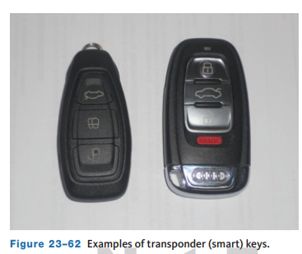
Smart Keys
Newer vehicles are equipped with a specially designed key, or fob.
They are commonly used with push button start systems.
To start the engine, the system must receive the correct signal from the key.
Transponder key systems set up communications between the vehicle’s PCM and the transponder in the key.
On many newer vehicles, the transponder does not need to be inserted; it just needs to be close to the vehicle.
This system is normally called a smart access system.

Slide 43
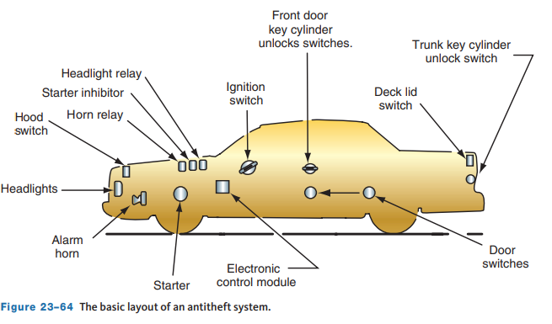
Alarm Systems
Antitheft systems are either installed by the OEM or are installed by aftermarket companies.
The basic idea of these systems is to scare away a thief and/or prevent the vehicle from starting.
The two methods for activating alarm systems are passive and active.
Passive systems switch on automatically when the ignition key is removed or the doors are locked.
Active systems are activated with a key fob transmitter, keypad, key, or toggle switch.

Slide 44
Chapter Reflection
Please take a moment to consider what you have learned about electrical accessories in this chapter. Then respond to the following questions in one or two paragraphs. Use 150–200 words in your reflection.
Did anything in this chapter interest you more than others? Describe any of the electrical accessories that interest you most.
Considering all you have learned, do you feel you are able to perform basic diagnosis and service of electrical accessories in the shop or lab setting? How can be more prepared?

